Slide 1
Internship Final Presentation
Presented By
MBA Summer Interns- April 2025 Batch
LOB: Commercial Excellence
Aman Sagar (A8511)
Ajaya Saipriya Sahoo (A8529)
Presenting to
Sahil Mahajan and Vicky Thakur
Date: 05-June-2025

Slide 2

Overview of Internship Journey
Key Objectives
Timeline Snapshot
Challenges Faced
Key Achievements and Impact
Key Learnings
Conclusion
Agenda

Slide 3
Overview of Internship Journey
To give a snapshot of two-month internship journey at Axtria
9-week Internship (April 7 – June 6) in Commercial Excellence (CE)
Reported to Pooja, mentored by Sahil
Worked on React-based Reporting Framework enhancements
Contributed to BRD creation for Strategic Account Planning (SAP)
Collaborated with cross-functional business and tech teams

Slide 4
Key Objectives
Gain foundational knowledge of the pharmaceutical domain, company policies, and key internal tools (NetSuite, Empower, etc)
Understand the business operations of Commercial Excellence at Axtria
Contribute to internal product enhancements and reporting frameworks
Learn and understand the usage of tools like Power BI, and React
Deliver mockups, documentation, and presentations with business impact
Collaborate across teams to understand strategic planning and delivery
Key Tasks:
IC Reporting Optimization: KT Sessions, contact with business teams to understand the difference between Power BI and React Reporting, Brainstorming and suggesting additional components for optimizations
IC Reporting Framework: Documentation formatting, and Presentation file for Sanofi; Mockups creation of suggested components
React Development: Learned React, built & optimized components, focused on reusability
SAP BRD Task: BRD creation and documentation for SAP tool

Slide 5
Timeline Snapshot
Week-1
Week-3
Week-4
Induction sessions and team introductions
Assigned to Commercial Excellence
Connected with mentor, and team
Self learning from Axtria Institue
Week-2
Introduction to IC Reporting Framework
Assignment briefing and goals defined
React framework exploration
Connected with Business Teams
Brainstorming ideas for optimization
Presentation of initial progress
Developed visual mockups and submitted first draft documentation
Integrated feedback from business connects
Drafted IC Reporting Framework PPT

Slide 6
Timeline Snapshot (Cont.)
Week-5 and 6
Week-8
Week-9
Power BI, Tableau exploration by connecting with business teams
Week-7
React learning continue
Fun Friday event planning and execution
Created mid-presentation
React learning started
React Components building
BRD task submission
Started Bayer BRD tasks
Explored SAP tool on SalesIQ Platform
Implementation of components in the current code
Code review session
Submission of react component (Map, Hamburger menu, Helpdesk) codes and corresponding document
Final presentation
Mentored into Product Management
KT sessions and iterative reviews

Slide 7
Challenges Faced
Technical Learning Curve: As an MBA student, learning React from scratch was challenging. Overcame this through self-learning, online documentation, AI tools, and mentorship from Sahil.
Client-Level Documentation: Converting technical notes into client-facing deliverables demanded a new level of structure and presentation.
Virtual Collaboration: Coordinating Fun Friday virtually and engaging with multiple stakeholders online required adaptability.
Dynamic Requirements: The SAP BRD task underwent multiple changes during execution, which required real-time adjustment and flexibility in approach.

Slide 8
Key Achievements and Impact
Delivered a professional enhancement proposal for the React reporting library with visual mockups & documentation
Translated technical gaps into business insights by benchmarking Power BI and React reports
Built scalable, reusable components (e.g., Map, MapSidebar, MapMarker, Helpdesk module, Hamburger menu, etc) in React
Designed and submitted the Business Requirements Document (BRD) for the SAP module
Earned appreciation for presentation quality, coding standards, and proactive collaboration

Slide 9
Key Learnings
Technical Skills:
Frontend Development: React.js, Node.js, Visual Studio Code
Data Visualization: Power BI, Tableau
UI/UX Design: Figma (Mockups & Wireframes)
Documentation & Reporting: BRD Templates, Visual Mockups
Soft Skills:
Daily interactions with cross-functional teams
Active participation in Fun Friday event organization
Frequent connects with mentors- Sahil, Vicky, Ketan
Learned importance of asking the right questions
Business:
Pharma Domain Knowledge, IC Reporting, Strategic Account Planning, BRD Creation

Slide 10
Conclusion
Deep thanks to Axtria for a transformative and empowering internship experience
Sincere appreciation to my mentor Sahil, for his trust, guidance, and constant encouragement
Grateful to Pooja and the Commercial Excellence team for their support and collaboration
Thankful for the opportunity to explore new domains, tools, and roles, especially Product Management
Special thanks to all cross-functional team members who contributed to my learning
I leave with confidence, respect for Axtria's culture, and lasting professional growth

Slide 11
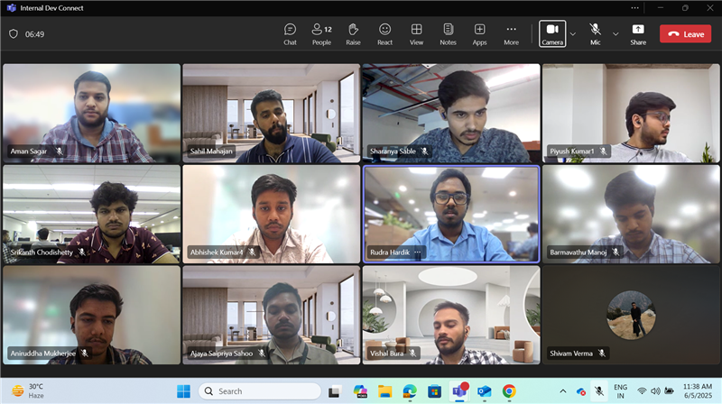
Thank you to the team. (Last Day: 5th June, 2025)

